Slide 1


SHOCKWAVE: Fair and Efficient GPU Sharing for Deep Learning Under Dynamic Adaptation
Pengfei Zheng, Rui Pan, Tarannum Khan,
Shivaram Venkataraman, Aditya Akella

Slide 2

SHARED CLUSTERS
FOR MACHINE LEARNING

Slide 3

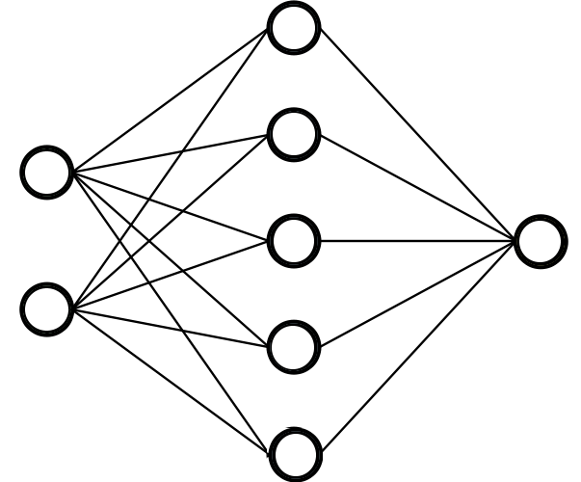

GPU Cluster SchedulING
Multiplex access to shared GPU cluster for contending DL apps
GPU Cluster Scheduler
Shared GPU cluster
Notes:
GPUs are being consolidated at large enterprises as a shared on-premise cluster or a cluster of cloud GPU instances.
With this consolidation, a GPU Cluster Scheduler is required to multiplex access to these GPUs for deep learning apps from several teams.

Slide 4
DYNAMIC ADAPTATION IN ML JOBS: GNS
Gradient Noise Scaling (GNS)
Adaptively double batch size based on gradient noise

Slide 5
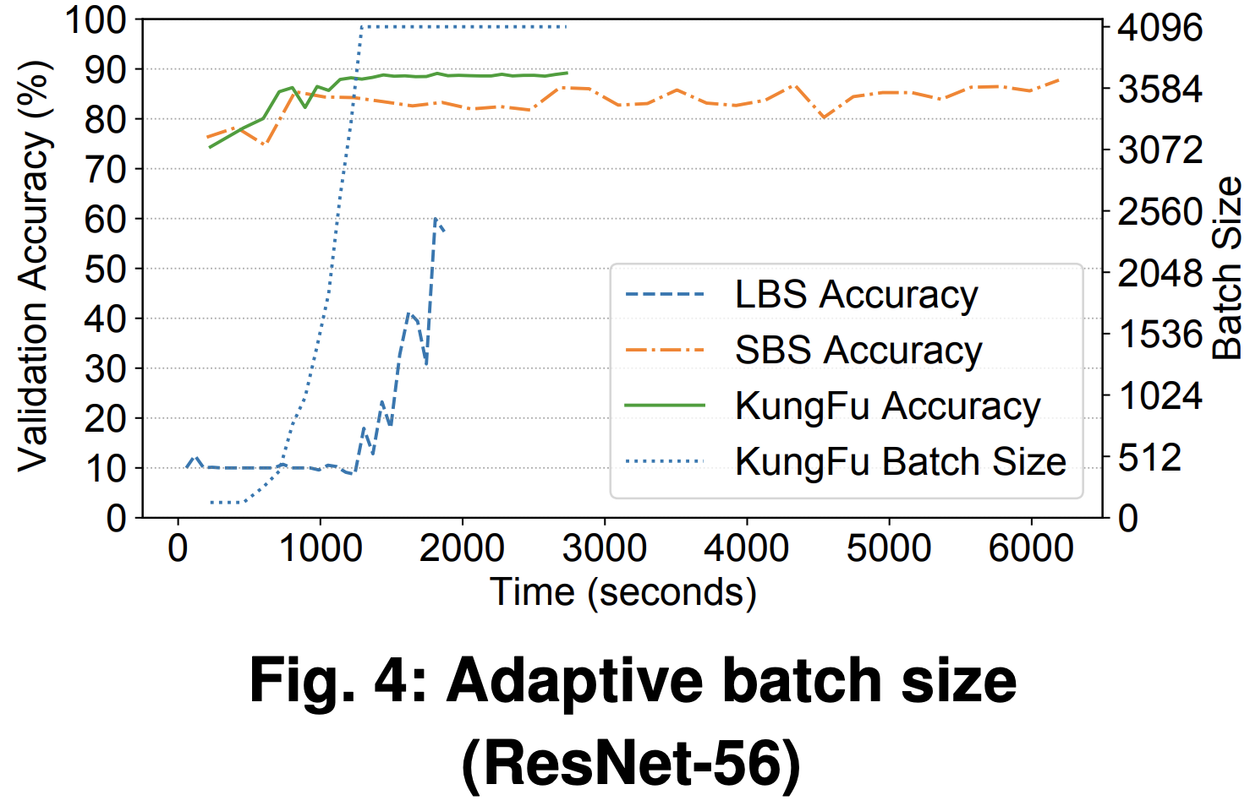
DYNAMIC ADAPTATION IN ML JOBS: GNS
Gradient Noise Scaling (GNS)
Adaptively double batch size based on gradient noise
Small Batch Size (16),
Large Batch Size (4096)
Batch size 16 → 32 → … → 4096
KungFu (OSDI 2020)

Slide 6
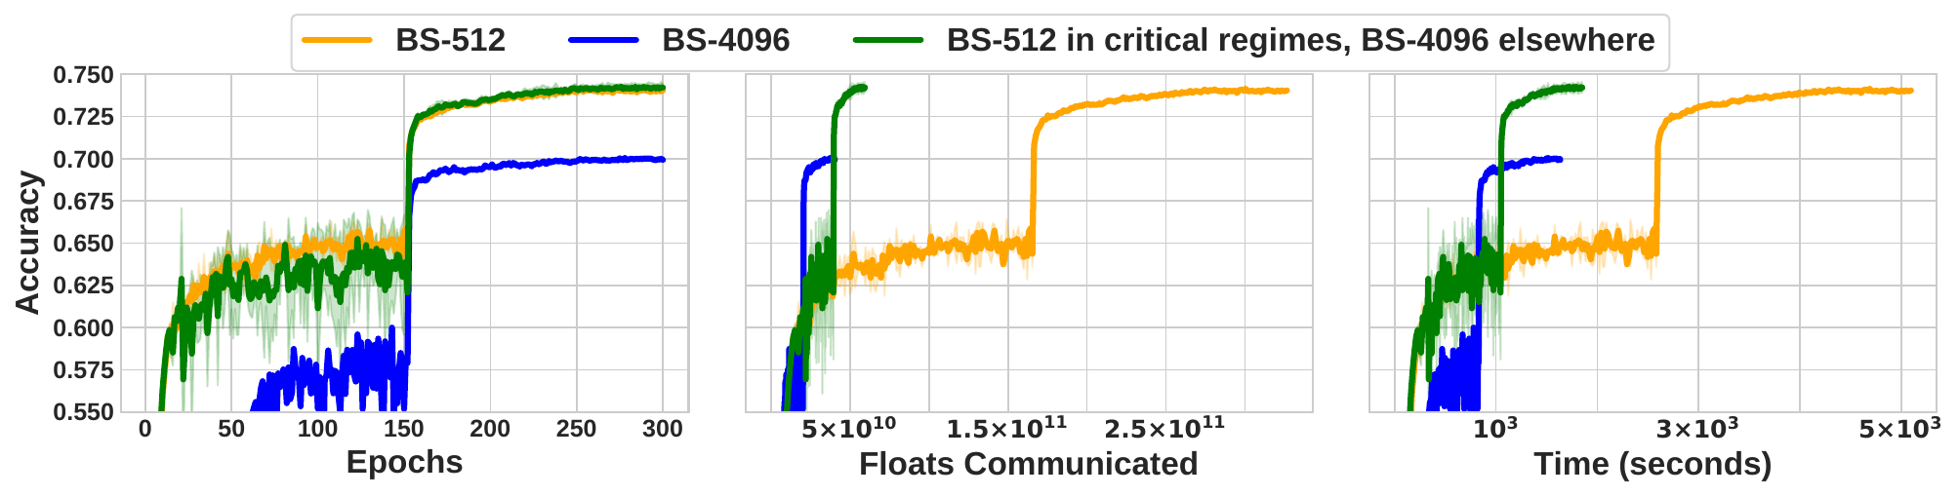
DYNAMIC ADAPTATION IN ML JOBS: ACCORDION
Use small batch size in critical regimes, large batch size elsewhere
Accordion (MLSys 2021)

Slide 7
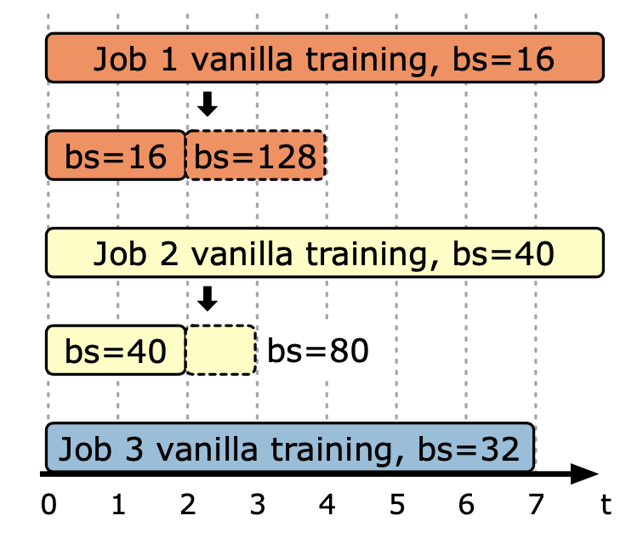
SCHEDULING WITH DYNAMIC ADAPTATION
Dynamic adaptation can affect Efficiency

Slide 8
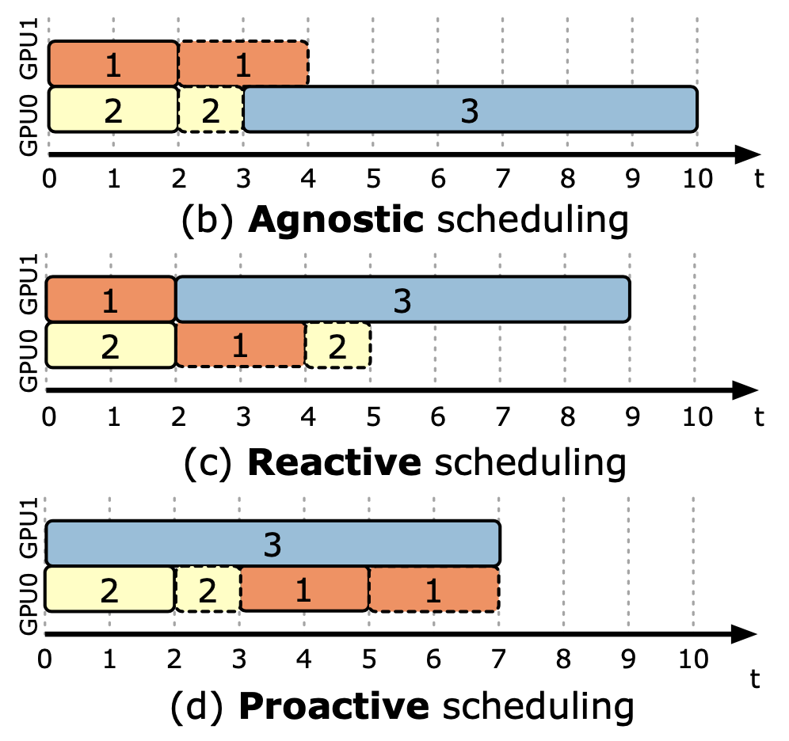
SCHEDULING WITH DYNAMIC ADAPTATION
Dynamic adaptation can affect Efficiency

Slide 9
SCHEDULING WITH DYNAMIC ADAPTATION
Dynamic adaptation can affect Efficiency

Slide 10
SCHEDULING WITH DYNAMIC ADAPTATION
Dynamic adaptation can affect Efficiency

Slide 11
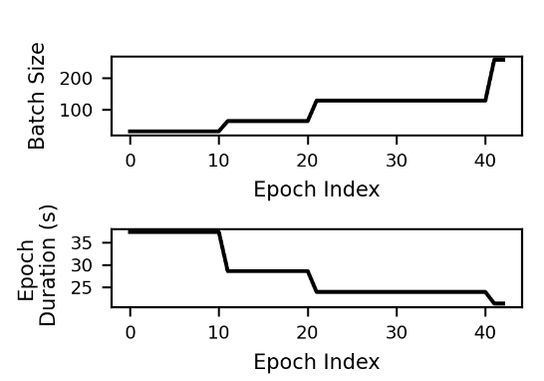
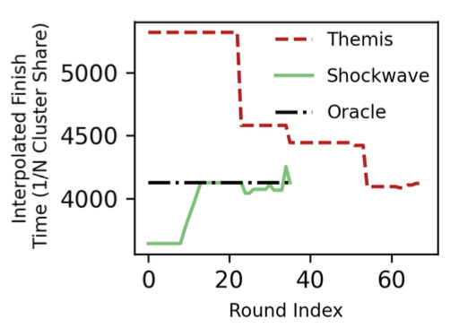
SCHEDULING WITH DYNAMIC ADAPTATION
Dynamic adaptation can affect Fairness
Leads to 2x worse than fair finish time

Slide 12
SCHEDULING WITH DYNAMIC ADAPTATION
Dynamic adaptation can affect Fairness
Leads to 2x worse than fair finish time
How do we achieve efficiency with long term fairness for dynamic ML jobs?

Slide 13
SHOCKWAVE
Shockwave: Fair and Efficient Scheduler under Dynamic Adaptation
Key contributions
Predictive model for Dynamic Adaptation
Market-based formulation with time-varying utility
Improves makespan by ~1.3x and fairness by ~2x

Slide 14
OUTLINE
Problem statement
Related work, Challenges
Shockwave Design
Evaluation

Slide 15
SoME Prior DL SCHEDULERS
Improve Cluster Utilization:
Gandiva (OSDI 2018), AntMan (OSDI 2020), HiveD (OSDI 2020)
Reduce Job-completion Time
Tiresias (NSDI 2019), Optimus (Eurosys 2019)
Optimize Goodput through Elasticity
SLAQ (SoCC 2017), Optimus (Eurosys 2019), Pollux (OSDI 2021)
Fair sharing across users:
Themis (NSDI 2020), Gandiva_{fair} AlloX(Eurosys 2020), Gavel (OSDI 2020)

Slide 16
CHALLENGE: INACCURATE ESTIMATES
Themis Objective: min (max ⍴)
Interface: Get finish time fairness (⍴) estimates from all apps
…
⍴₁
>
⍴₂
>
⍴₃
>
⍴_{N}
Notes:
Themis overcomes these issues. Themis mechanism operates in two steps. In the first step, we filter top 1-f fraction of apps with max rho values and in the second step we allocate available GPU resources (the Red GPUs in this case) to one or more of these filtered apps using partial allocation auctions.

Slide 17
CHALLENGE: INACCURATE ESTIMATES
Themis Objective: min (max ⍴)
Interface: Get finish time fairness (⍴) estimates from all apps
…
Dynamism → Inaccurate Estimates
⍴₁
>
⍴₂
>
⍴₃
>
⍴_{N}
Notes:
Themis overcomes these issues. Themis mechanism operates in two steps. In the first step, we filter top 1-f fraction of apps with max rho values and in the second step we allocate available GPU resources (the Red GPUs in this case) to one or more of these filtered apps using partial allocation auctions.

Slide 18
CHALLENGE: FILTERING ON PAST ALLOCATIONS
Themis objective – min (max ⍴)
…
⍴₁
>
⍴₂
>
⍴₃
>
⍴_{N}
1 – f
f
Filter 1 – f apps with worst ⍴ values
Allocate to one or more of 1 – f apps for next round using partial auctions
Notes:
Themis overcomes these issues. Themis mechanism operates in two steps. In the first step, we filter top 1-f fraction of apps with max rho values and in the second step we allocate available GPU resources (the Red GPUs in this case) to one or more of these filtered apps using partial allocation auctions.
Filtering looks in the past
Market-based approach – but that is not the main thing. We are solving for the future.
Flip thesea

Slide 19
CHALLENGE: FILTERING ON PAST ALLOCATIONS
Themis objective – min (max ⍴)
…
Filter only looks at past allocations
⍴₁
>
⍴₂
>
⍴₃
>
⍴_{N}
1 – f
f
Filter 1 – f apps with worst ⍴ values
Allocate to one or more of 1 – f apps for next round using partial auctions
Notes:
Themis overcomes these issues. Themis mechanism operates in two steps. In the first step, we filter top 1-f fraction of apps with max rho values and in the second step we allocate available GPU resources (the Red GPUs in this case) to one or more of these filtered apps using partial allocation auctions.
Filtering looks in the past
Market-based approach – but that is not the main thing. We are solving for the future.
Flip thesea

Slide 20
SHOCKWAVE DESIGN
Approach
Prediction-based approach that captures long-term fairness and efficiency
Mechanism for allocations that accounts for future rounds
Key Design Components
Bayesian model to predict utility under dynamic adaptation
Input to a market-based solver that gives us provable guarantees.
Notes:
Market formulation to allocate elastic shares to jobs
Jobs receive a budget to purchase GPU-time
Use budget to maximize performance until resources are exhausted
Equal purchasing power, ensures fairness

Slide 21
SHOCKWAVE: PREDICTING DYNAMIC ADAPTATION
Challenge: Predict utility of future epochs in presence of dynamic adaptation

Slide 22
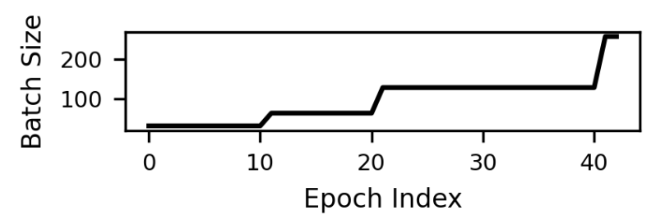
SHOCKWAVE: PREDICTING DYNAMIC ADAPTATION
Challenge: Predict utility of future epochs in presence of dynamic adaptation
Handful of patterns used for dynamic adaptation
Accordion: Alternating batch sizes over epochs
GNS: Doubling batch size over epochs

Slide 23
SHOCKWAVE: PREDICTING DYNAMIC ADAPTATION
Challenge: Predict utility of future epochs in presence of dynamic adaptation
Handful of patterns used for dynamic adaptation
Accordion: Alternating batch sizes over epochs
GNS: Doubling batch size over epochs
Approach: Model dynamic adaptation as a mixture of regimes
Use profiles for each batch size regime

Slide 24
SHOCKWAVE: PREDICTING DYNAMIC ADAPTATION
Mixture of regimes with different batch sizes
Example - Job i 100 epochs:
30 epochs (30%) for BS-512,
70 epochs (70%) for BS-4096
Notes:
A standard Bayesian posterior update rule
assumes the epoch samples of individual regimes are inde- pendently and randomly drawn as training progresses. But this does not hold in practice. Epochs of the 𝑘-th regime can only emerge if the 𝑘 − 1-th regime finishes.
updates the prior’s parameters that correspond to completed epochs, while continuing to be- lieve that the ongoing and future regimes will evenly split the remaining epochs

Slide 25
SHOCKWAVE: PREDICTING DYNAMIC ADAPTATION
Mixture of regimes with different batch sizes
Example - Job i 100 epochs:
30 epochs (30%) for BS-512,
70 epochs (70%) for BS-4096
Use a Dirichlet prior to model the mixture
Job i Prior: Dir(50%, 50%): 50 epochs BS512,
50 epochs BS-4096
Observe batch scaling and update the posterior
Job i Posterior: Dirichlet (65%, 35%): 65 epochs for BS512, 35 epochs for BS-4096
Notes:
A standard Bayesian posterior update rule
assumes the epoch samples of individual regimes are inde- pendently and randomly drawn as training progresses. But this does not hold in practice. Epochs of the 𝑘-th regime can only emerge if the 𝑘 − 1-th regime finishes.
updates the prior’s parameters that correspond to completed epochs, while continuing to be- lieve that the ongoing and future regimes will evenly split the remaining epochs

Slide 26
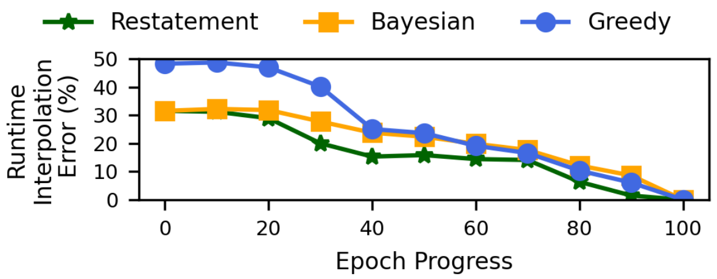
SHOCKWAVE: PREDICTING DYNAMIC ADAPTATION
Mixture of regimes with different batch sizes
Example - Job i 100 epochs:
30 epochs (30%) for BS-512,
70 epochs (70%) for BS-4096
Use a Dirichlet prior to model the mixture
Job i Prior: Dir(50%, 50%): 50 epochs BS512,
50 epochs BS-4096
Observe batch scaling and update the posterior
Job i Posterior: Dirichlet (65%, 35%): 65 epochs for BS512, 35 epochs for BS-4096
Temporal-dependence across epochs
Restatement rule: only updates parameters for completed epochs
Notes:
A standard Bayesian posterior update rule
assumes the epoch samples of individual regimes are inde- pendently and randomly drawn as training progresses. But this does not hold in practice. Epochs of the 𝑘-th regime can only emerge if the 𝑘 − 1-th regime finishes.
updates the prior’s parameters that correspond to completed epochs, while continuing to be- lieve that the ongoing and future regimes will evenly split the remaining epochs

Slide 27
SHOCKWAVE: DYNAMIC MARKETS
Goal: Scheduling policy that accounts for the past and future utilities
Market theory: Provable guarantees for efficiency, fairness.
Notes:
We define the market to have reached an equilibrium when two conditions are satisfied. (a) Optimal Spending: Each job’s utility accrued over time, i.e, 􏰂𝑇𝑡=1 𝑢𝑖𝑡 , is maximized under its budget. (b) Work-conserving: There are no leftover resources if the price for the resources is non-zero
Equilibrium achieved with optimal spending and work conservation

Slide 28
SHOCKWAVE: DYNAMIC MARKETS
Goal: Scheduling policy that accounts for the past and future utilities
Market theory: Provable guarantees for efficiency, fairness.
Static market: Every training job has a known, time-invariant utility U(x)
Utility U(x): map allocated GPU-time to training throughput for a job
Volatile Fisher Market (VFM) in Shockwave
Operate at discrete time intervals (rounds)
Every training job has a time-variant utility U_{t}(x) for each round (t)
Solve for allocation that leads to market equilibrium
Notes:
We define the market to have reached an equilibrium when two conditions are satisfied. (a) Optimal Spending: Each job’s utility accrued over time, i.e, 􏰂𝑇𝑡=1 𝑢𝑖𝑡 , is maximized under its budget. (b) Work-conserving: There are no leftover resources if the price for the resources is non-zero
Equilibrium achieved with optimal spending and work conservation

Slide 29
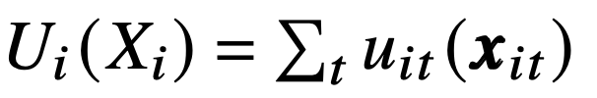
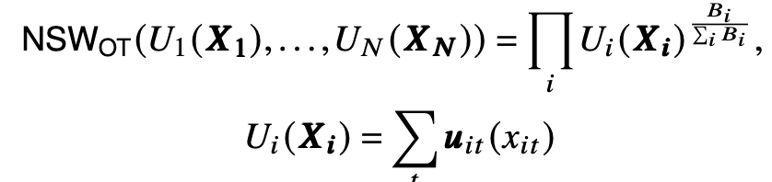
SHOCKWAVE: DYNAMIC MARKET PROPERTIES
Maximizes Nash Social Welfare over time
Maximizes cluster-wide utility
Efficiency
Notes:
geometric mean of job progress is maximized for a 𝑇 -round-long time horizon.
Overall cluster-wide utility is maximized across all jobs, thus leading to improved utilization

Slide 30
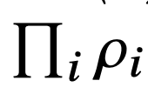
SHOCKWAVE: DYNAMIC MARKET PROPERTIES
Maximizes Nash Social Welfare over time
Minimizes product of FTF over time
Minimize
= (Finish time in a shared cluster)
(Finish in an 1/N exclusive cluster)
Maximizes cluster-wide utility
Provides sharing incentive
Efficiency
Fairness
Notes:
geometric mean of job progress is maximized for a 𝑇 -round-long time horizon.
Overall cluster-wide utility is maximized across all jobs, thus leading to improved utilization

Slide 31
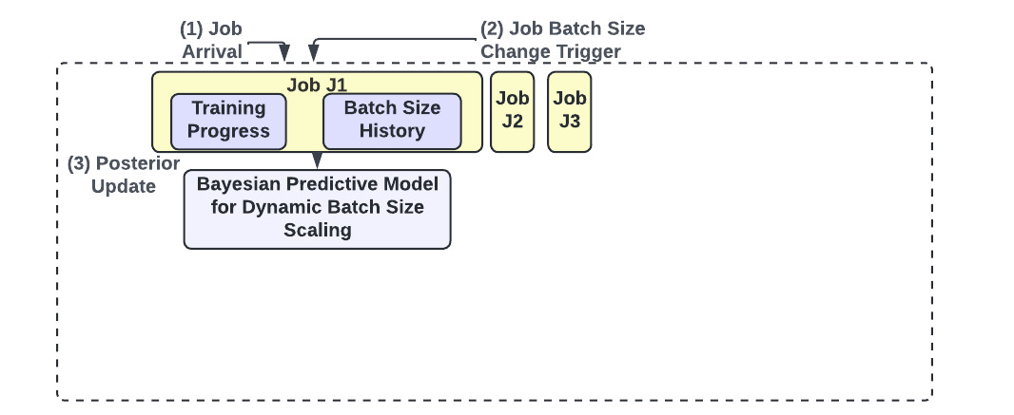
SHOCKWAVE ARCHITECTURE
Notes:
Each round is 2 mins, plan for 20 rounds ahead
Animate this figure by steps

Slide 32
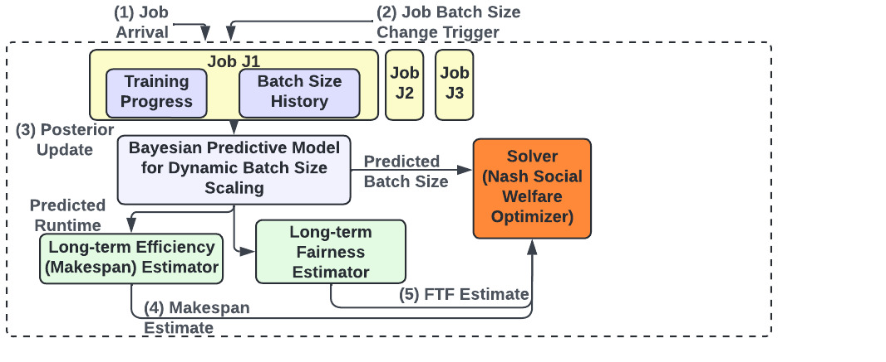
SHOCKWAVE ARCHITECTURE
Notes:
Each round is 2 mins, plan for 20 rounds ahead
Animate this figure by steps

Slide 33
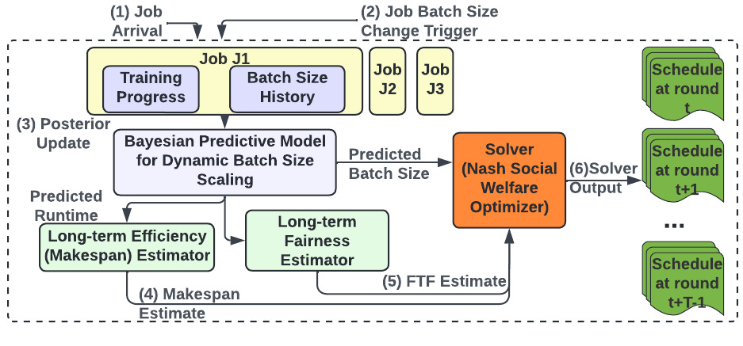
SHOCKWAVE ARCHITECTURE
Notes:
Each round is 2 mins, plan for 20 rounds ahead
Animate this figure by steps

Slide 34
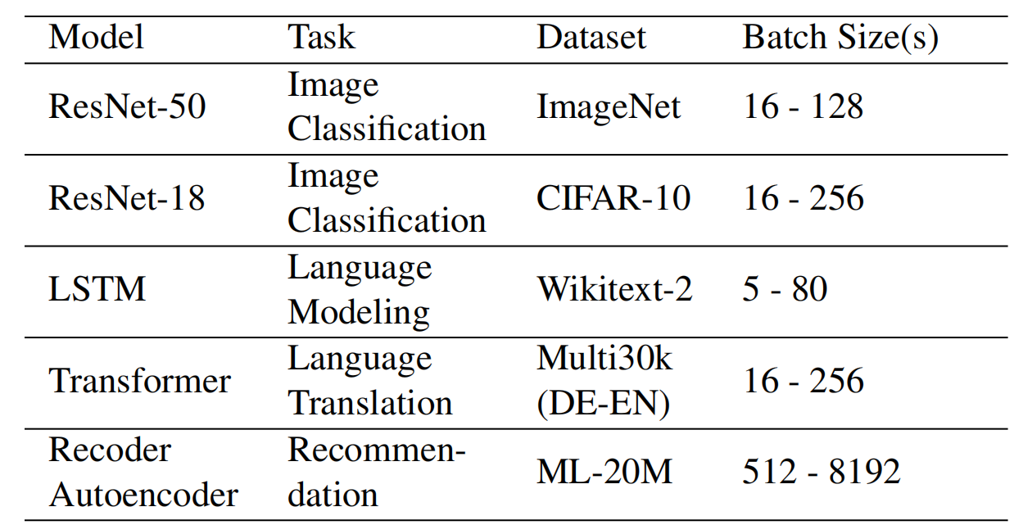
EVALUATION
Testbeds
32 Nvidia Quadro RTX5000 GPUs (16GB) at TACC
Simulated clusters with 64-256 GPUs
High simulation fidelity (<5% deviation)
Workloads
Gavel Workload Generator (OSDI’20)
Microsoft’s Philly trace (ATC’19)
Mix of GNS and Accordion jobs (50%-50%)

Slide 35
END-TO-END COMPARISONS
32-GPU Cluster in TACC, Gavel trace
Notes:
Efficiency: Makespan on average 1.3× less than Themis, Gavel, and AlloX
Fairness: Finish Time Fairness (FTF) outperforms Themis, Gavel, and AlloX by 2× on average
Responsiveness: Average JCT is comparable to Themis, Gavel and AlloX
Robustness: FTF is resilient to predictive errors for dynamic adaptation
Makespan Themis 1.24x, AlloX 1.27, Gavel 1.37
Unfair Themis 2, Gavel 3.2x, AlloX 3x

Slide 36
END-TO-END COMPARISONS
32-GPU Cluster in TACC, Gavel trace
Reduces Makespan by ~1.3x, Unfair fraction by ~2x
Notes:
Efficiency: Makespan on average 1.3× less than Themis, Gavel, and AlloX
Fairness: Finish Time Fairness (FTF) outperforms Themis, Gavel, and AlloX by 2× on average
Responsiveness: Average JCT is comparable to Themis, Gavel and AlloX
Robustness: FTF is resilient to predictive errors for dynamic adaptation
Makespan Themis 1.24x, AlloX 1.27, Gavel 1.37
Unfair Themis 2, Gavel 3.2x, AlloX 3x

Slide 37
END-TO-END COMPARISONS
32-GPU Cluster in TACC, Gavel trace
Reduces Makespan by ~1.3x, Unfair fraction by ~2x, maintains JCT
Notes:
Efficiency: Makespan on average 1.3× less than Themis, Gavel, and AlloX
Fairness: Finish Time Fairness (FTF) outperforms Themis, Gavel, and AlloX by 2× on average
Responsiveness: Average JCT is comparable to Themis, Gavel and AlloX
Robustness: FTF is resilient to predictive errors for dynamic adaptation
Makespan Themis 1.24x, AlloX 1.27, Gavel 1.37
Unfair Themis 2, Gavel 3.2x, AlloX 3x

Slide 38
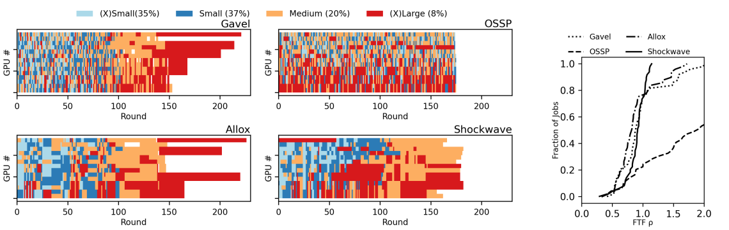
COMPARING SCHEDULERS: EFFICIENCY
Notes:
Remove OSSP, MST from the figure, ​
Keep Gavel, Allox, Themis and another version with just Themis, Allox​

Slide 39
COMPARING SCHEDULERS: EFFICIENCY
Notes:
Remove OSSP, MST from the figure, ​
Keep Gavel, Allox, Themis and another version with just Themis, Allox​

Slide 40
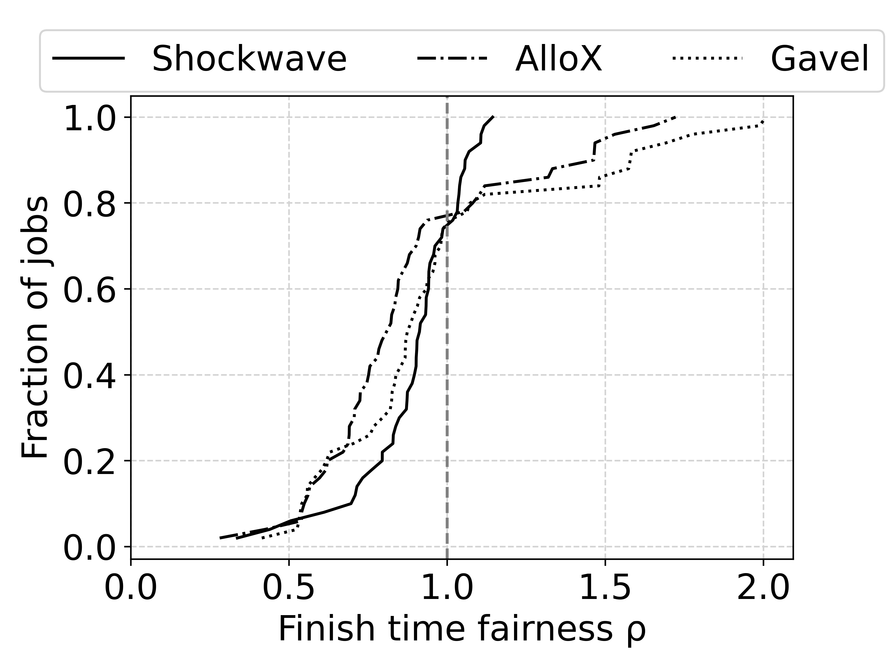
COMPARING SCHEDULERS: EFFICIENCY
Shockwave minimizes Makespan
while lowering the number of jobs with unfair allocations
Notes:
Remove OSSP, MST from the figure, ​
Keep Gavel, Allox, Themis and another version with just Themis, Allox​

Slide 41
CONCLUSION
Dynamic Adaptation introduces challenges for fairness and efficiency
Shockwave: New predictive scheduler that uses a Market-based formulation
Bayesian model for predicting dynamic adaptation
Time-varying utility and provable guarantees on fairness and efficiency
Open source: https://github.com/uw-mad-dash/shockwave
Questions?

